Slide 1
IoT Based Real time Sleep Apnea screening system

Slide 2
Group Members:
Abdur Rab Dhruba 1712441642
Kazi Nabiul Alam 1711217042
Shakib Khan 1711661042
Supervisor: DR. MOHAMMAD MONIRUJJAMAN KHAN
Associate Professor at North South University, PhD, Electrical and Electronic Engineering, Queen Mary University of London, UK B.Eng. Electrical and Electronic Engineering, Queen Mary, University of London, UK.

Slide 3
Background Study & Problem Statement
There are two kinds of Sleep Apnea:
Obstructive Sleep Apnea (OSA)
Central Sleep Apnea (CSA)
According to research, around 3 to 7% of the Male and 2% to 5% of the Female are suffering from sleep apnea that sum up approximately more than 100 million people in the world including adolescents. Interestingly, 80% of Apnea cases remain undiagnosed. Children of around 1 to 4% at age between 2 to 8 suffer from sleep apnea (OSA mostly) and 20% of them snores. It varies in different parameters, like who is affected, who is not.

Slide 4
Existing system review, our proposed solution:
There we found more technical research based on sleep apnea:
Wearable e-textile sensors
Developed the WatchPAT device
Real-time ECG monitoring
Our goal is to measure the maximum of these values like: SpO2, Heart Rate, ECG, Skin response, sound and such parameters at a time. Besides, in earlier research, these values were measured overnight and then they got the data, but we want to make it lively like, if any complications arise, someone concerned may be notified via IoT device..

Slide 5
Output of the project:
we need to know the expected result of those indexes:
Heart Rate: When we sleep, it is expected to be at the low end of normal, or even below; for example, a healthy, fit person can have a heart rate of 50-60 bpm while sleeping. But heart rate of a person with sleep disorders is less than a healthy person’s heart rate.
SpO2: Normal Oxygen saturation level (SpO2) is 94%-95% and 91%-96% is a healthy oxygen saturation level. But during sleep apnea the rate could be drop to below 90%.
ECG: The ECG value changes significantly during sleep apnea, but for healthy person the change is lesser.

Slide 6
Major Milestones
1
2
3
4
Problem designing and proposal.
Finding all equipment.
Circuit Design with the equipment.
Buying the equipment.
Arduino Code.
Hardware Setup.
Completion Hardware part.
Connecting With the Mobile.
Data Analysis.
Testing full project
Report Writing.
Journal Writing.

Slide 7
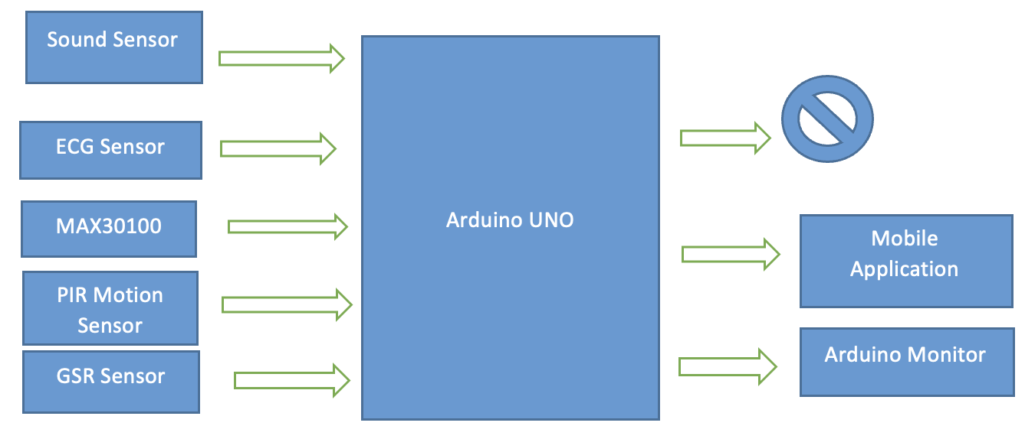
Outline of system
The Arduino board which is also connected with the output layer combined with the serial monitor of the Arduino Board and a MIT App Inventor based mobile application connected with a Bluetooth module to show the converted digital data to the viewer.

Slide 8
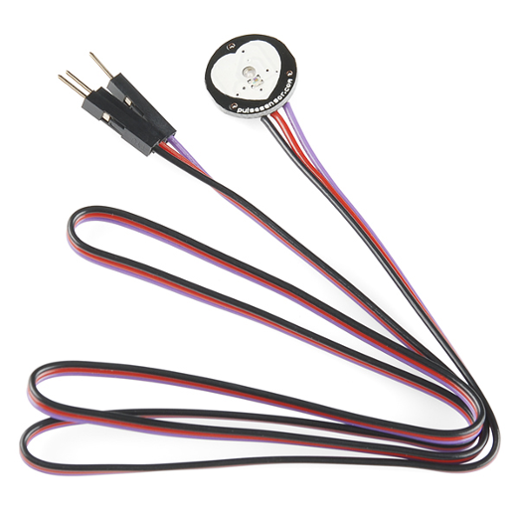
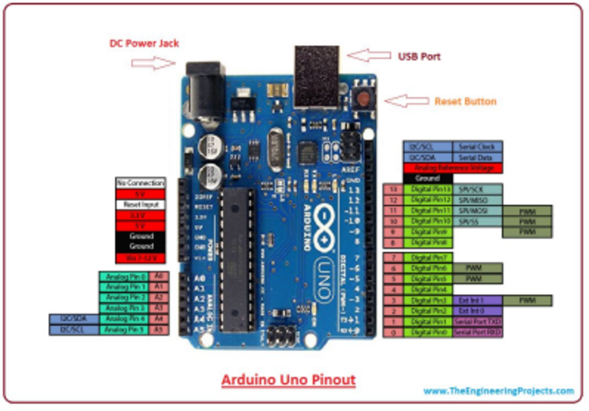
Materials
Arduino Uno
Heart Pulse Sensor.

Slide 9
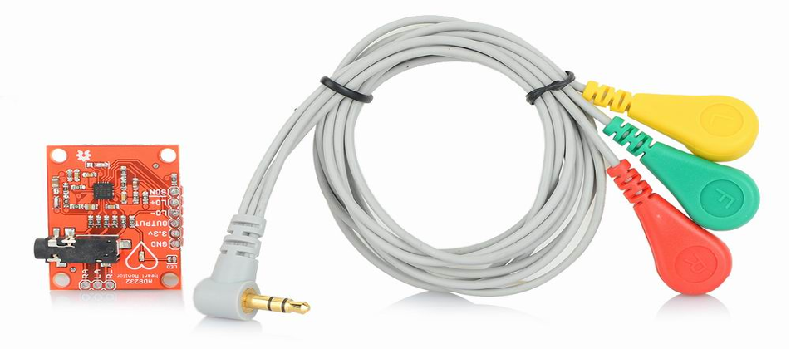
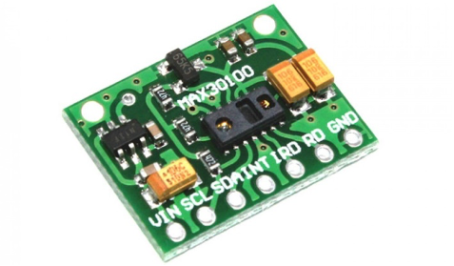
Materials
AD8232 ECG Sensor.
Max30100 SpO2 sensor.

Slide 10
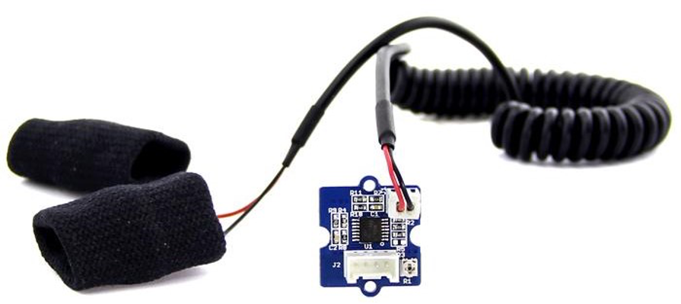
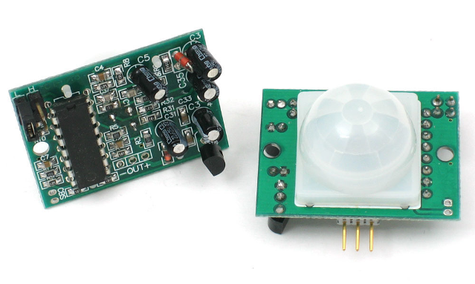
Materials
Galvanic Skin Response(GSR) sensor.
PIR Sensor

Slide 11
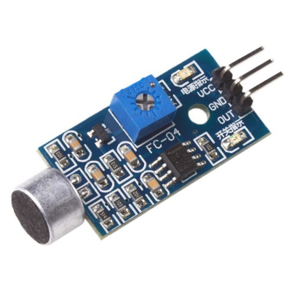
Materials
Sound Sensor

Slide 12
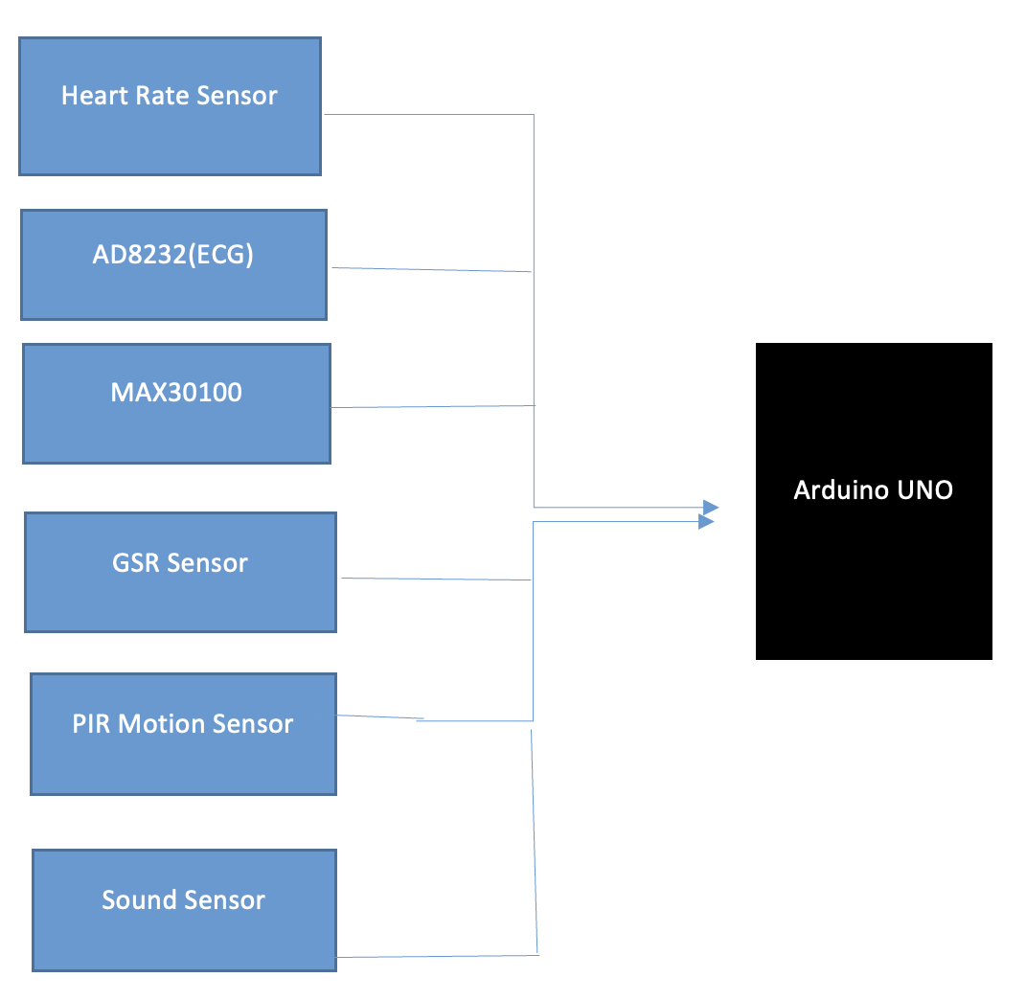
Input Subsystem

Slide 13
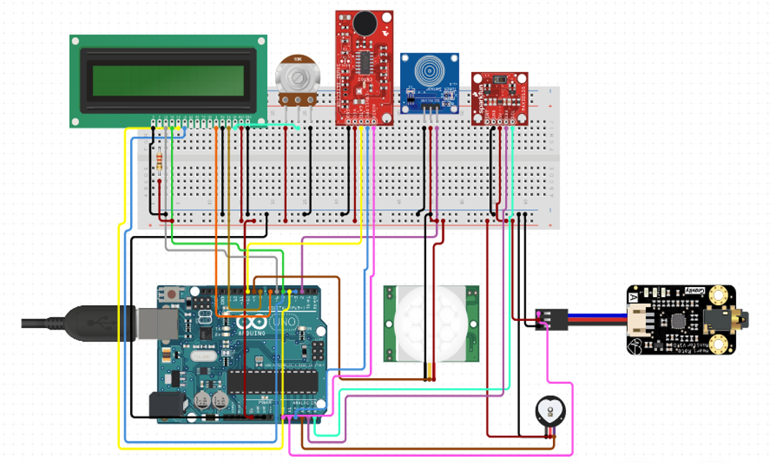
Circuit Diagram of the full system.

Slide 14
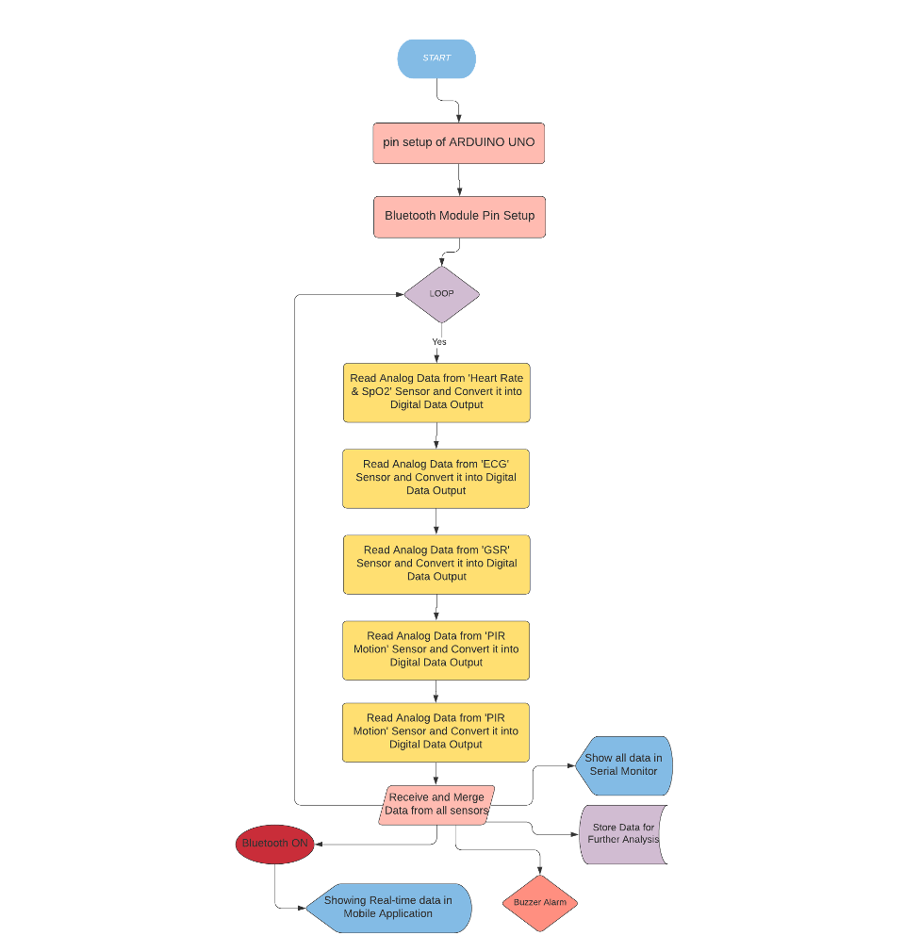
Flow-Chart
of full system.
Diagrams drawn using MS Word
or MS Visio showing flow chart for processing.

Slide 15
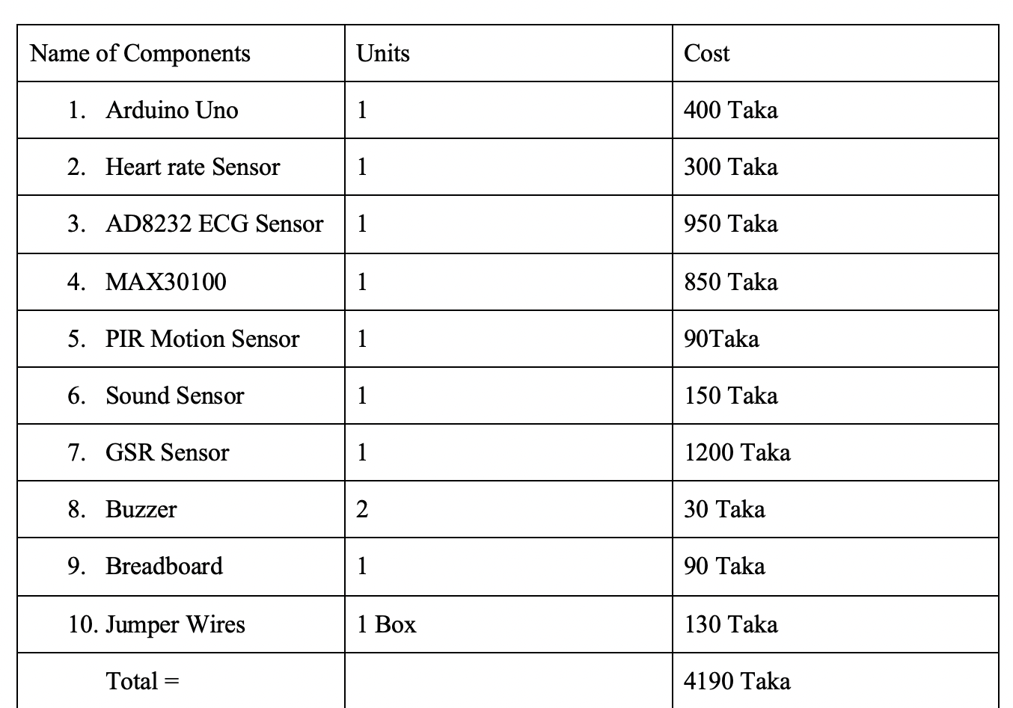
Approximate Cost

Slide 16
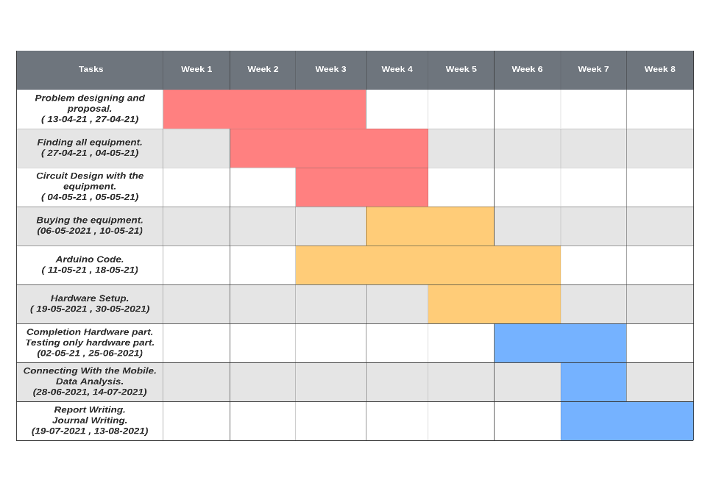
Gantt Chart

Slide 17
Is there any opportunity of income generation from the project?
Yes we can generate income from this project . If we can make fully automated devices and risk free devices so that we can sell it to the market with lost cost.

Slide 18
Do you need financial support for future extension?
We may need financial support as these sensors and systems are costly, moreover, the clinical environment it needs to sleep apnea detection, is more complex and costly for high level research.

Slide 19
How will people be benefitted from the project?
By detecting your sleep apnea, it can reduce your risk of heart disease. Sleep apnea is linked to a variety of heart problems because it causes you to stop breathing many times each night. These breathing pauses cause changes in your blood pressure and can reduce your blood oxygen levels. This puts an enormous strain on your heart. Using this device we can give an alert if anything is wrong with your heart rate.[31]
Stroke - Can reduce your risk of stroke, one of the leading causes of death and long-term disability. A stroke is a sudden loss in brain function. It occurs when there is a blockage or rupture in one of the blood vessels leading to the brain. People with untreated sleep apnea are two to four times more likely to have a stroke.
Diabetes - To treat your sleep apnea can improve insulin sensitivity. Sleep apnea is related to glucose intolerance and insulin resistance, both factors in type 2 diabetes. Untreated sleep apnea increases your risk of getting type 2 diabetes.
Emotional Stability - Untreated sleep apnea increases your risk of depression. Reducing your risk of depression and improving your overall quality of life

Slide 20
What are the risks? How the risks will be managed?
Sleep apnea can cause a lot of risk to human health. Sometimes it causes death. It can cause a heart attack, stop breathing while people are snoring. Also it can cause the stroke as well. So by detecting Sleep apnea we can reduce the risk of people Health [31]. On the other hand the device we create for detecting the sleep apnea has some risks. There are no health risks of using our device. But there may occur some hardware or system bug in this screening process. Risks like the wire we used may be disconnected from the devices. Sometimes the sensor may stop working with the movement of the patient. Sometimes the data we extract can't come out as predicted values due to external factors like room temperature , humidity, and other factors. Here, we will try to make our device as compacted and as accessible as possible.

Slide 21
What is the positive impact on the environment, social, economic, design?
Our device has a positive impact on the environment. It is fully environmentally friendly. It has a huge positive impact on society and the economy. It helps people to live a good life by giving an alarm about your sleep condition. Introducing this device to the market can contribute to increasing the economy of our county. And the design of the device is very user friendly. People can easily use this device.

Slide 22
Disabled will benefit?
Yes the disabled people will benefit from this project. We have a special feature that, when any alarming data comes during real-time screening, a buzzer will buzz and patient attendants will be notified immediately. So, the physically or mentally disabled will be benefited as they can use this with ease and they shouldn’t have to worry about.

Slide 23
What is the value for money?
Devices used in Sleep Apnea screening in the market are much more costly and hard to find onn regular basis [32]. But we’ll try to make our device more gettable, patients as well as normal people can access our device easily, because every single price of the system (sensors, microcontroller, data extraction and so on ) that we kept in mind, and tried to make it as simple and as cheap as possible.

Slide 24
THANK YOU
END

